Slide 1
Bus Performance A
Team A
AlHasan Bahaidarah, Salma Alali, Isaac Chan, Tiansui Gu, Jasmine Fanchu Zhou

Slide 2
Project Overview
Project motivation: Bus as a public transportation is one of the most important services provided by Massachusetts Bay Transportation Authority (MBTA).To improve the MBTA bus service, MBTA wants to understand and examine the disparity in bus performance pattern based on geographical location.
Goal: To provide insights into the quality and reliability of bus performance and demographics of bus riders. To further identify the potential areas for improvement.
Background needed: Public transportation context knowledge, navigation across the Census, MBTA, and other public transportation database and performance measurement metrics.

Slide 3
Brief Summary of Answered Base Questions

Slide 4
Extension Project
Topic: How is bus routes/stops usage associated with Blue Bike usage?
Goal: To identify the potential association between Bus on-time Performance with demand of bus and demand of Blue Bike.
Questions answered:
Where are bluebikes station hotspots compared to bus stops?
What are the average number of trips from stations going along the best and worst bus routes?
Data used:
Blue Bike data for 2022 from Blue Bike Website (Stations and Trip Histories)
Census Neighbourhood data
MBTA Bus transit reliability
MBTA GTFS-Map (Mapping stops to neighbourhoods)

Slide 5
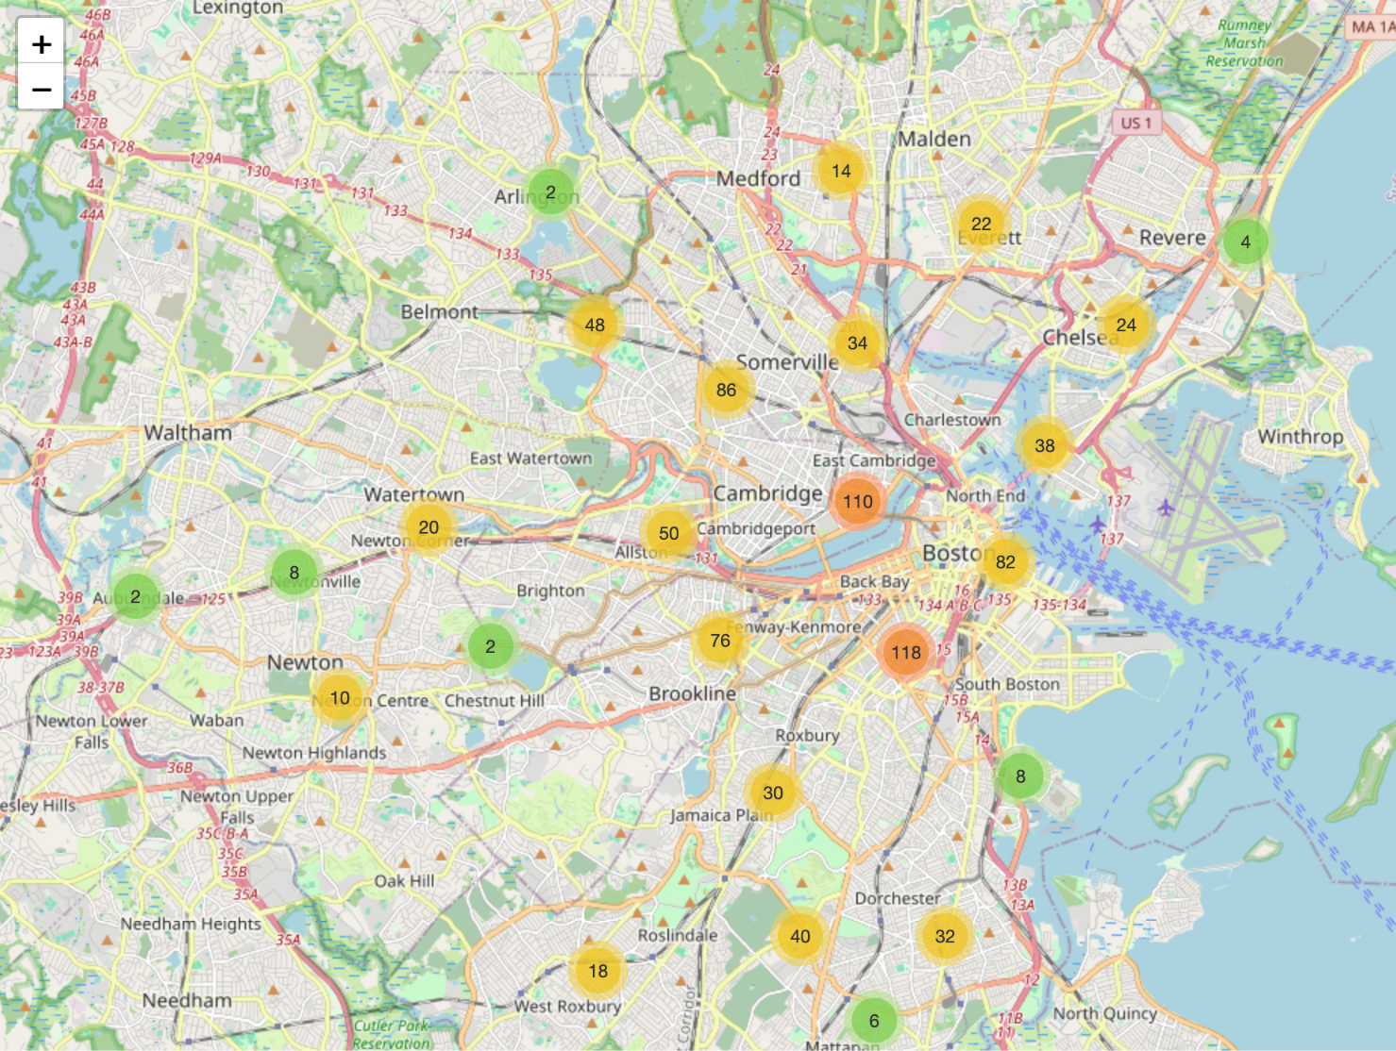
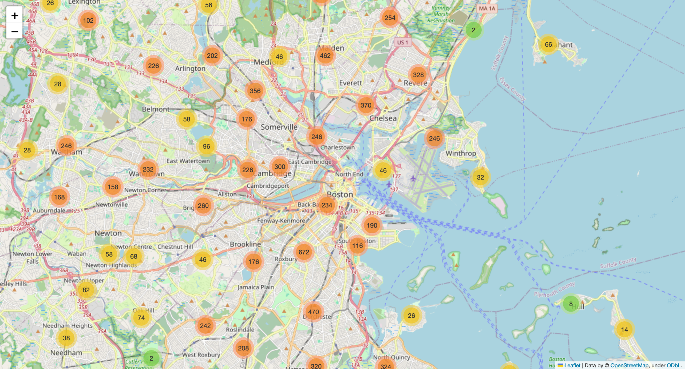
Blue Bike station to Bus station ratios
Notes:
We then tried to compare the locations of the stops with the locations of the bike stations in hopes of relating to see where they were grouped and try to see if we can come up with any deductions using that. This is important given our previous research into favored treatment per neighborhoods. Pointing us towards the direction of availability more than quality of service.

Slide 6
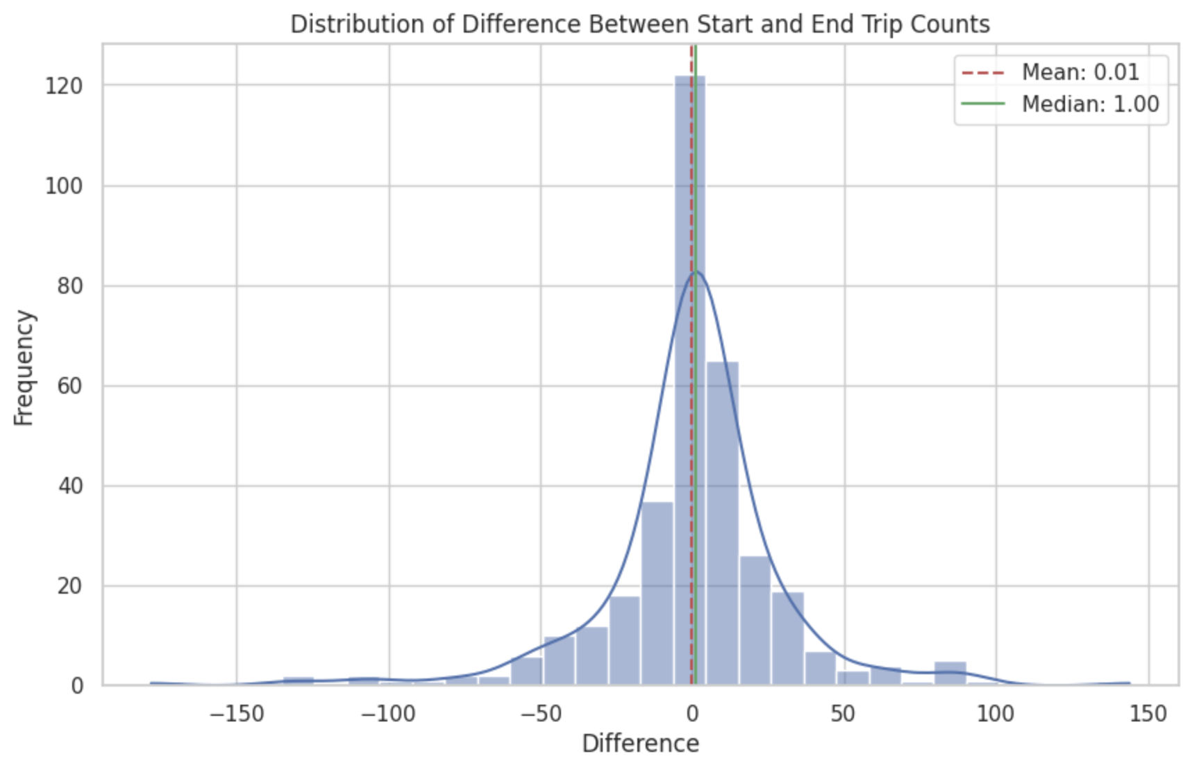
Bike Trip Counts Relating to Bus Routes
Notes:
Docking / taking the bikes
Graphed distribution of start and end trip counts
We were able to analyze blue bike trip data and merge that data to match the bus routes from the mbta dataset. From this, we derived docking and undocking numbers and graphed the distribution of trip counts, finding important values like the mean and median.

Slide 7
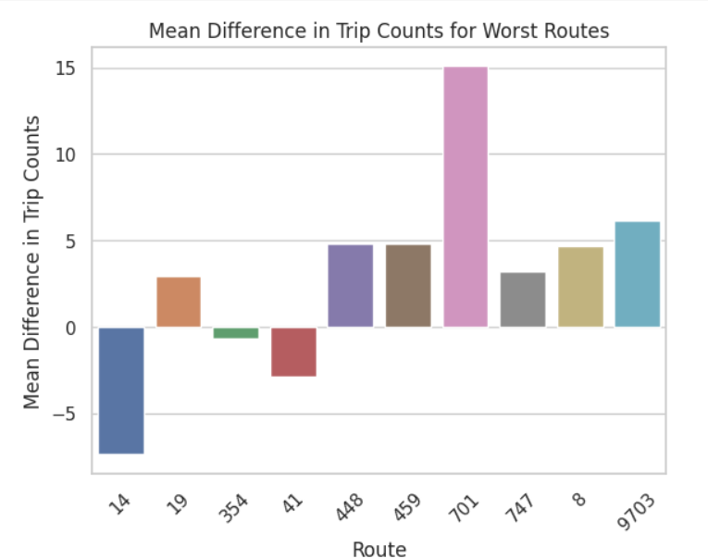
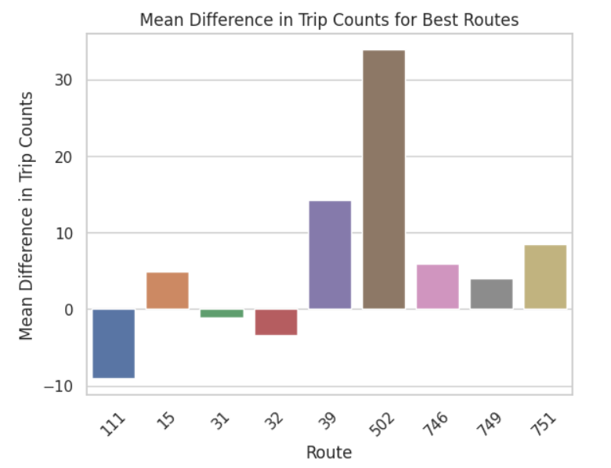
Best vs Worst Comparison
Notes:
We also took the mean difference in trip counts for the best 10 and worst 10 routes. We can observe that the mean difference in trip counts seems to be larger for the best routes compared to the worst routes. We can potentially draw a correlation between bus route on-timeness and bluebike station location, since the best routes seem to have more dockings than undockings.

Slide 8
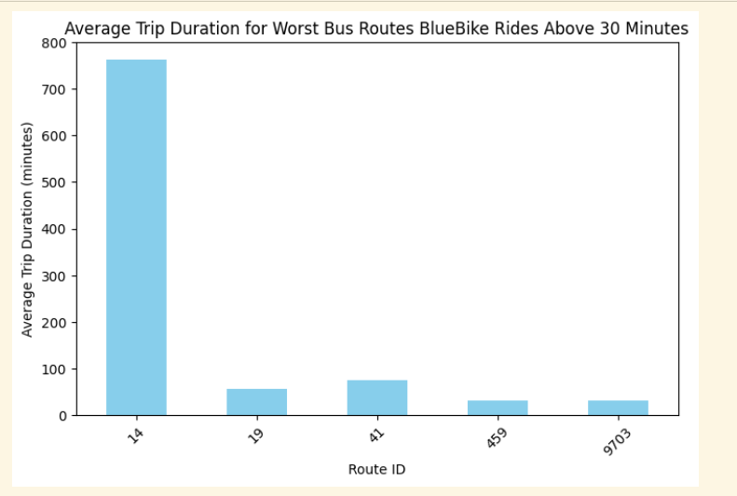
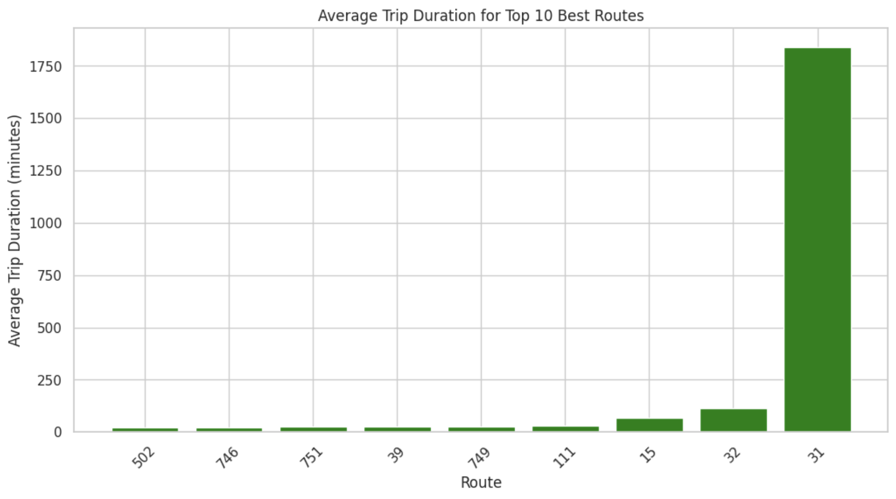
Bike Trip Duration Relating to Bus Routes
Notes:
Averages are high on account of abnormally long trips, which we explored further in the following slide.

Slide 9
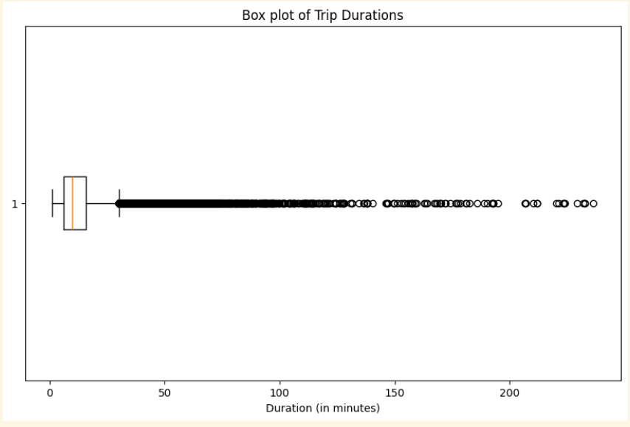
Bluebikes Trip Durations
Notes:
The outliers look like they are a lot, however they are of little significance compared to the median that lies between 10-15 minutes. We did not exclude this from our data because users using for hours may be people who did not correctly dock their bikes or may be explorers of the city taking their bikes along with them wherever.

Slide 10
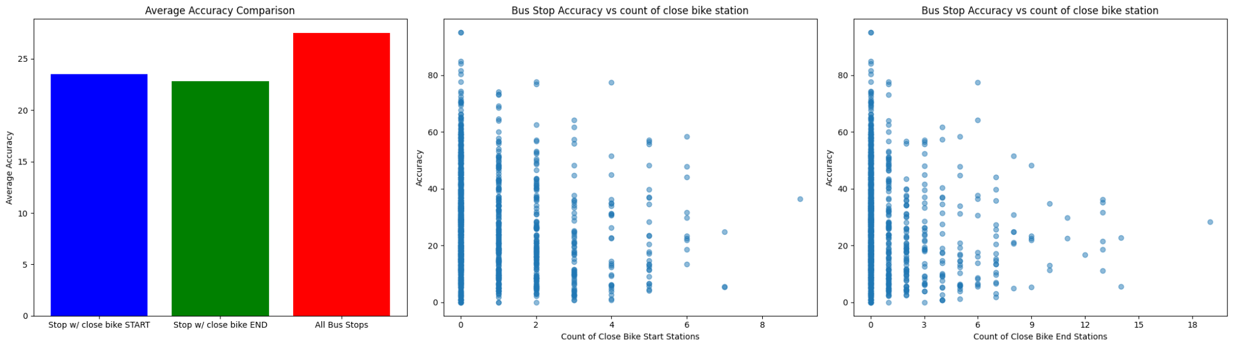
Bus Stop Accuracy versus bike station around it
We say a bike station is close to a bus station if they are within about 500m
It seems that bus stops where there are at least one bike station has less accuracy
Notes:
And from the scatter plots on the right, we can see that the more bike stations around a bus stop, there is a greater probability to have less accuracy

Slide 11
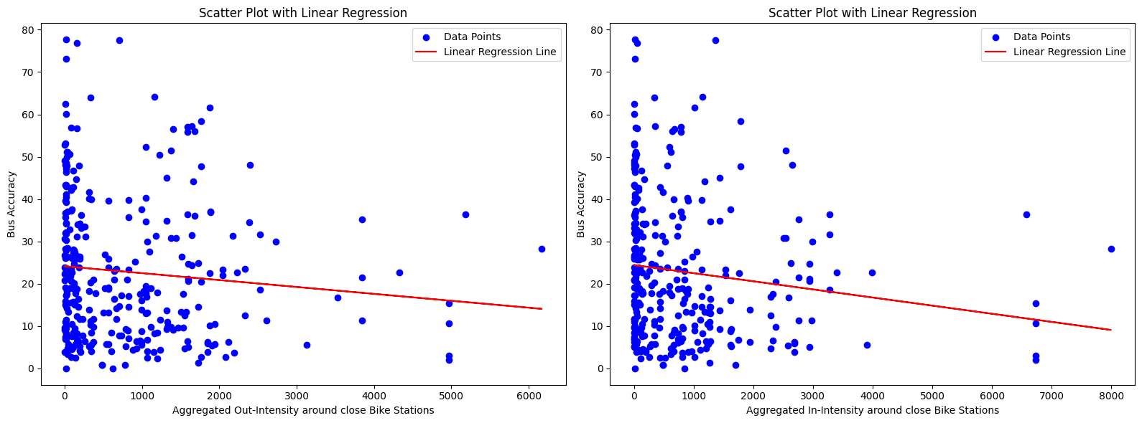
Using bike station intensity to correlate bus accuracy
Intensity calculated simply by usage of that station within 1 month
A MLR( Accuracy ~ In-intensity + Out-intensity) does not exclude 0 in 95% CI

Slide 12
Thank you

